Slide 1



Slide 2
Economic Outlook:
The Great Expansion and the Roaring 20s
Doug Woodward
Director, Division of Research
Professor of Economics

Slide 3

Overview
Looking ahead:
Challenges facing South Carolina’s economy
  Aging expansion
  Slow economic growth
  Falling growth in private investment
Looking back:
Regional performance in the Great Expansion
  Ten years after the Great Recession
  Winners in the economic marathon
    Growing Population
    Expanding Employment
    Rising Standard of Living Income
Looking ahead: Role of higher education
  Where graduates go in South Carolina

Slide 4
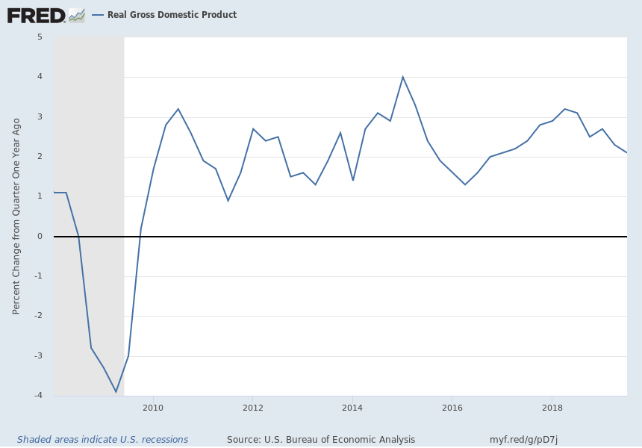
The Great Expansion: 2009-2019
Longest on record
Sustaining growth
  Less financial fragility
  No prices shocks
  Fiscal stimulus
  Easier monetary policy
Roaring 20s?

Slide 5

Long-Run Challenges
Investment spending falling
  Portends slow growth
Government spending rising
  Defense
Can this keep going?

Slide 6
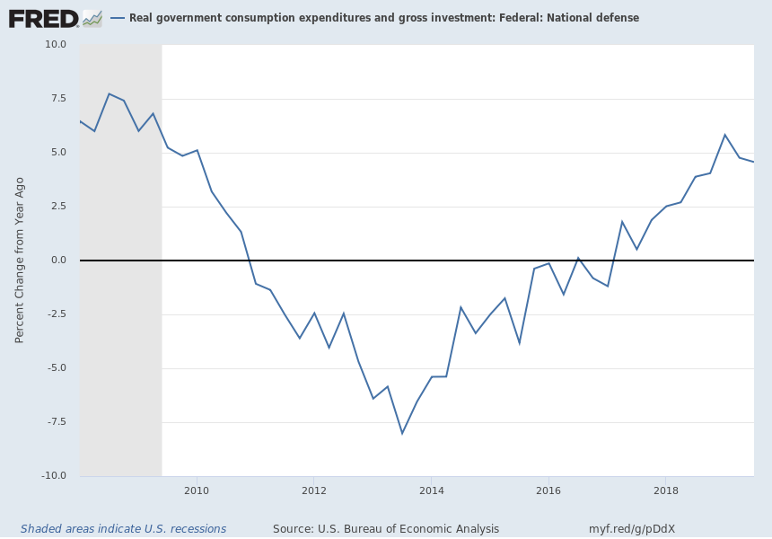
U.S. Defense Spending Growth

Slide 7
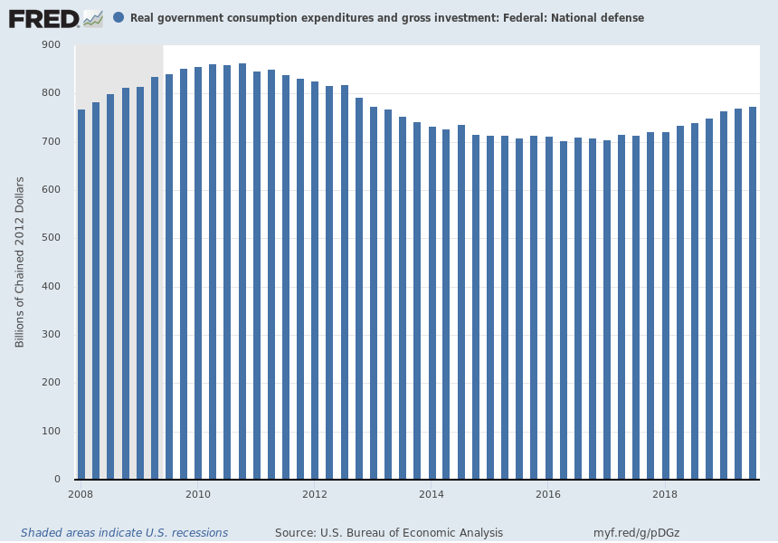
U.S. Defense Spending Level

Slide 8
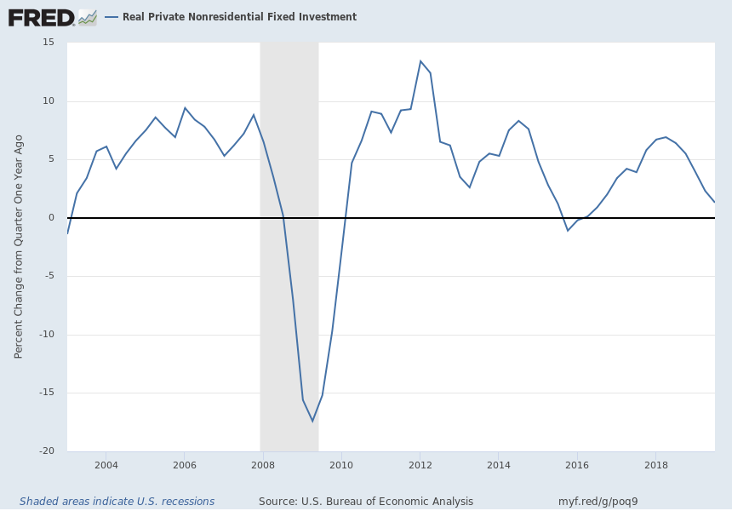
U.S. Business Investment Growth

Slide 9
Latest Quarterly U.S. Investment Spending
Q3 2019 -3.0%
Q2 2019 -1.0%
Q1 2019 4.4%
Q4 2018 4.8%
Q3 2018 2.1%
Q2 2018 7.9%
Q1 2018 8.8%
Q4 2017 8.4%
During Q3 2019:
Spending on structures down 15.3%.
Spending on equipment fell 3.8%.

Slide 10
Importance of Business Investment
  Private spending on:
    equipment and structures
    computers, software, and research and development
  Benefits:
    productivity
    long-run economic growth

Slide 11
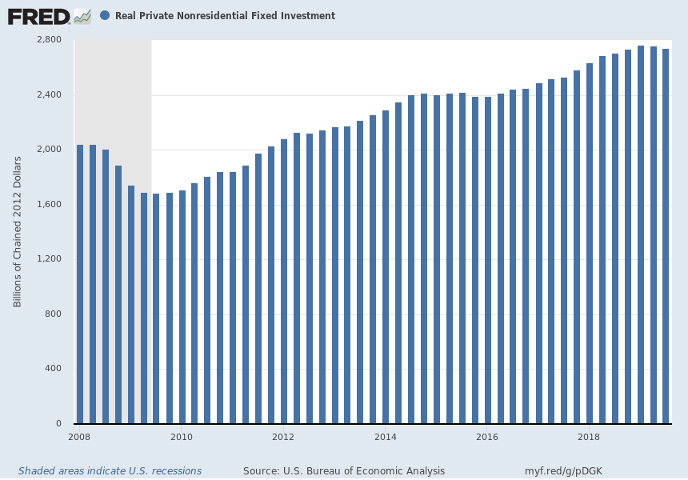
U.S. Business Investment Level

Slide 12
U.S. Business Investment Growth

Slide 13
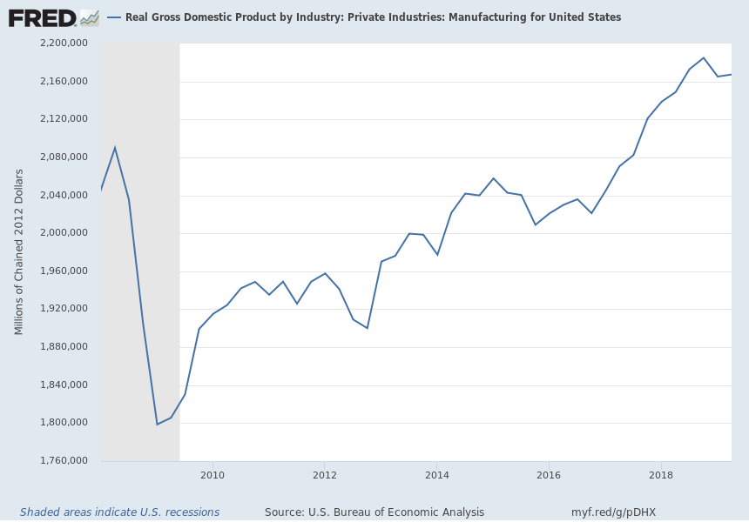
U.S. Manufacturing Output

Slide 14

Drivers of Business Investment
Private sector decisions:
  Profits
  Anticipated growth
  Risk taking
Public policy:
  Lower business (corporate) tax rates
  Accelerated depreciation
  Reduced regulatory burden

Slide 15
Outlook 2020: Falling Investment
End of an era: Investment slowing
Example: German automotive companies and suppliers scaling back
  Stagnant demand in China, the U.S, and Europe
  Trade war
  Continental announced tens of thousands of job cuts in 2019
    Closing plants, including Newport News, VA
Faces an expensive shift from internal combustion engines
Uncertainty about policy

Slide 16
U.S. Business Investment Opportunities
Great Expansion
Manufacturing
Oil and gas energy
Tech
  4-G
  E-commerce
  Disruptors
Roaring 20s
Manufacturing
New energy
Tech
  5-G
  Electric cars
  E-commerce
  More disruptors

Slide 17
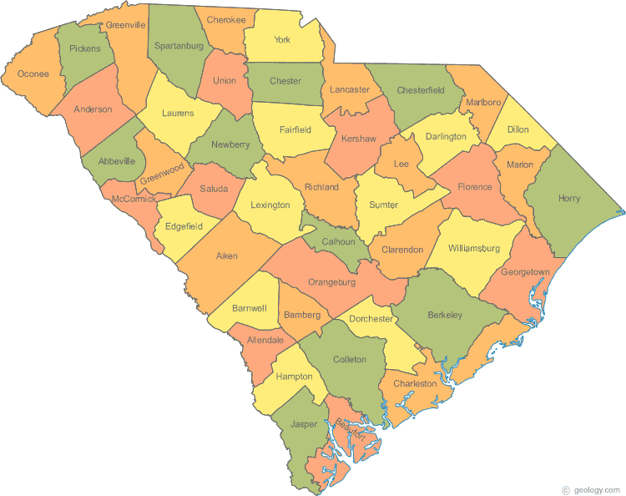
Looking Back: How has South Carolina Performed
in the Great Expansion?
Growth
  Population
  Employment
  Income

Slide 18
Expanding Population
U.S. Census Bureau (2019). ACS Community Survey

Slide 19
Growing Jobs
U.S. Census Bureau (2019). ACS Community Survey

Slide 20
Rising Standard of Living
U.S. Census Bureau (2019). ACS Community Survey

Slide 21
Higher Education
U.S. Census Bureau (2019). ACS Community Survey

Slide 22
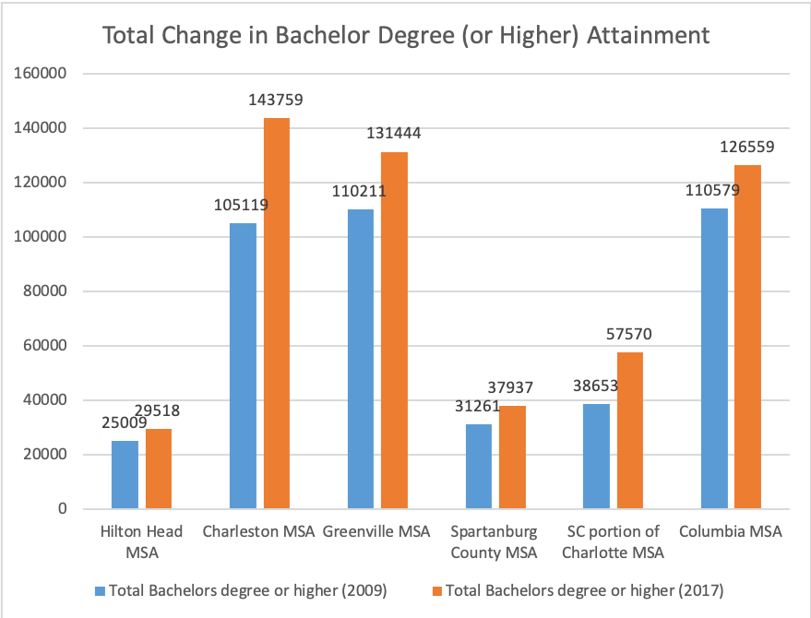
Higher Education
U.S. Census Bureau (2019). ACS Community Survey

Slide 23

Charleston: Winning College-Educated Labor
+ Large increase in share of adult population with four-year degree
+ Largest educated labor pool
= Greatest income growth

Slide 24
Challenges in the Midlands
Talent
  good base, but not Raleigh and below U.S.
Entrepreneurial and business environment
  Healthy, but few HQs
  Slow growth in professional and technical businesses and occupations
Innovative activity
  low for university town
Cluster development
  Weak

Slide 25
Clusters
Business synergies from geographical proximity
Traded, or export clusters
  drive regional and national development
  draw value (income) from outside the area
  Local retail, commercial, other local services depend on traded clusters to survive
Midlands
  Insurance
  Hydrogen fuel cells
  Nuclear

Slide 26

Next Expansion: Flagship University Role
  Catalyst for economic development
  Need leadership
  Boost talent
    Major challenge
  Boost investment
    Partnerships like IBM/Siemens/BMW
    Defense
      Army Futures Command

Slide 27
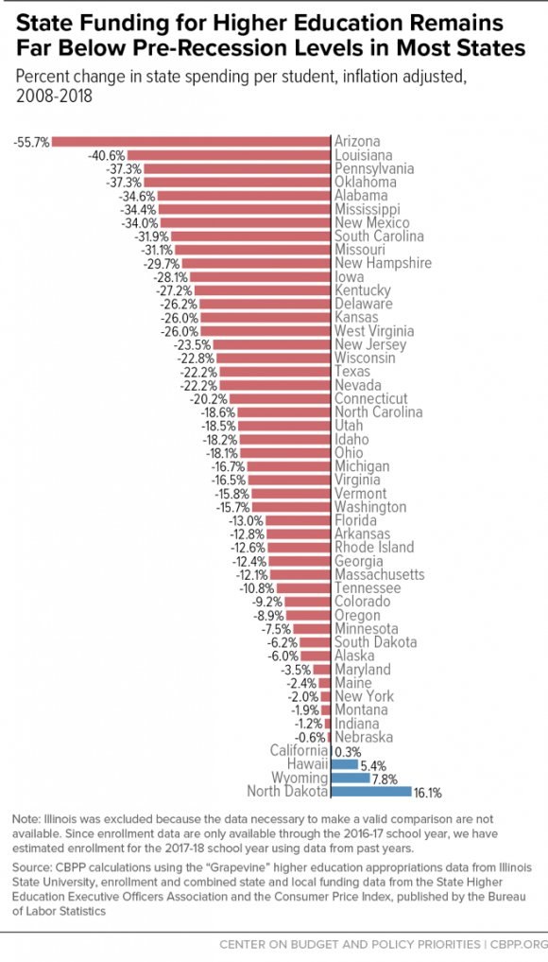
Major Challenge
Center for Budget and Policy Priorities (2019)

Slide 28

Summary
Great expansion
Roaring 20s!
Prepare
  Attract capital
  Cultivate talent

Slide 29


Happy Holidays!

