Slide 1



Slide 2
The 2020 South Carolina
Economic Outlook
Joseph Von Nessen, Ph.D.
Research Economist
joey.vonnessen@moore.sc.edu

Slide 3


Is a Recession Looming?
U.S. Expansion
2009-???

Slide 4
What’s New in 2019?
Tariff Effects are Now More Visible
Tax Stimulus Wearing Off
Fed Policy Reversal

Slide 5
U.S. GDP Growth (Annualized)
2.1%
Source: U.S. Bureau of Economic Analysis

Slide 6
U.S. GDP Growth (Annualized)
3.1%
2.1%
2.1%
Source: U.S. Bureau of Economic Analysis

Slide 7
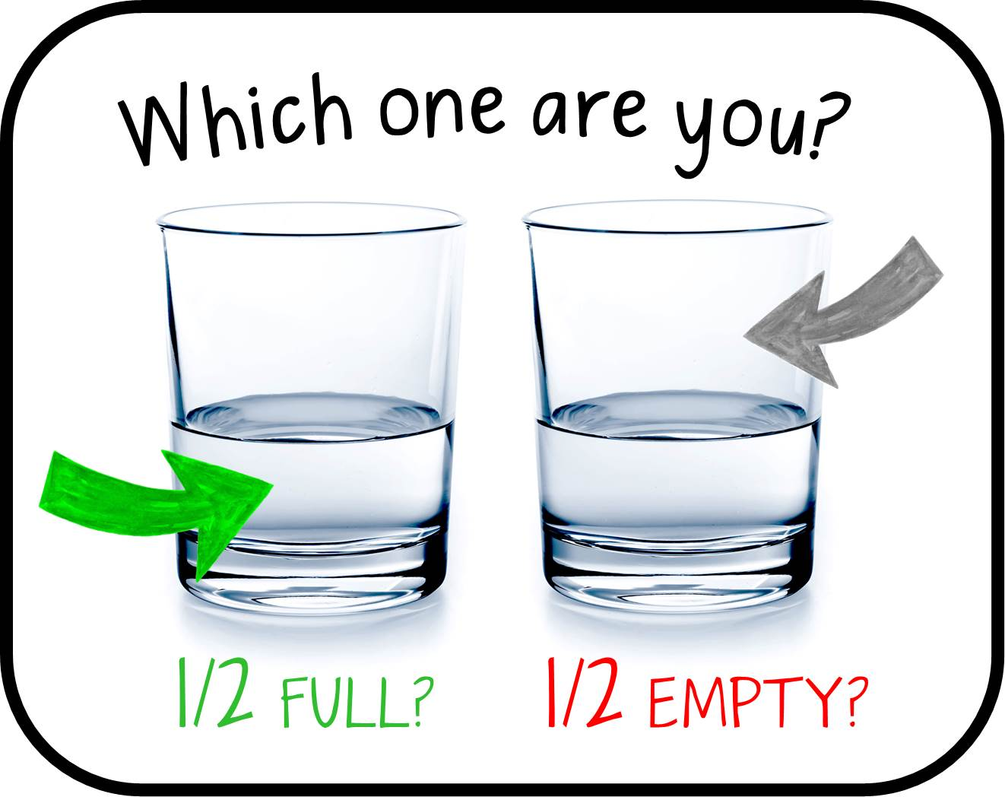

Slide 8
The Trade Talks Persist...
2018 U.S. tariffs
  10 percent tariffs on $250 billion of Chinese goods implemented
2018 China retaliates
  Duties on $110 billion of U.S. goods
  40 percent tariff on U.S. autos
2019 Ongoing Negotiations…
  January: Chinese auto tariffs reduced to 15 percent
  May: U.S. tariffs increased from 10 percent to 25 percent
  October: U.S. delays further tariff increases as a “Phase I trade deal” becomes more likely

Slide 9
China’s GDP Growth (Annualized)
+6.0%
Source: Trading Economics, November 2019

Slide 10
Eurozone GDP Growth (Annualized)
+0.2%
Source: Trading Economics, November 2019

Slide 11
Germany’s GDP Growth (Annualized)
+0.1%
Source: Trading Economics, November 2019

Slide 12
Institute for Supply Management (ISM) Index
Expanding
Contracting

Slide 13
U.S. Gross Output by Industry
Year/Year Pct. Change
 | q217 | q218 | q219 | LTM Change
Manufacturing | +4.1% | +7.4% | +1.7% | -5.7%
Services | +4.8% | +6.4% | +4.2% | -2.2%
All Industries | +4.8% | +6.5% | +3.5% | -3.0%
Source: U.S. Bureau of Economic Analysis

Slide 14
Total Employment Growth: U.S. vs. S.C.
YTD (January – September)
Source: U.S. Bureau of Labor Statistics, CES, NSA

Slide 15
U.S. Job Openings Rate vs. Unemployment Rate
U.S. Unemployment Rate: 3.6%
S.C. Unemployment Rate: 2.6%
Source: U.S. Bureau of Labor Statistics, JOLTS SA; CES SA

Slide 16
Average Hourly Earnings of all U.S. Employees
Source: U.S. Bureau of Economic Analysis

Slide 17
U.S. Nominal Wage Growth
Source: U.S. Bureau of Labor Statistics, Sept. 2019, 3-Yr. Rolling Average

Slide 18


Slide 19
Real Personal Consumption Expenditures
Year/Year Change, in Billions
Source: U.S. Bureau of Economic Analysis

Slide 20
U.S. Consumer Sentiment
Source: University of Michigan

Slide 21

“Small business optimism declines but remains historically high.”
- NFIB Research Foundation, Sept. 2019

Slide 22

What about South Carolina?

Slide 23
South Carolina Employment Growth
+1.4%
Source: U.S. Bureau of Labor Statistics, CES, NSA (Year/Year Pct. Change)

Slide 24
South Carolina Employment Growth
+1.4%
Source: U.S. Bureau of Labor Statistics, CES, NSA (Year/Year Pct. Change)

Slide 25
S.C. Employment Growth
Source: U.S. Bureau of Labor Statistics, CES, NSA

Slide 26
S.C. Employment Growth
Source: U.S. Bureau of Labor Statistics, CES, NSA

Slide 27
How are auto tariffs affecting manufacturing in South Carolina?
Short-run effects: Increased Costs
Long-run effects: Potential Changes in Global Production Strategies

Slide 28
South Carolina Export Volume (TEUs)
Annual Growth Rate: Rolling 3-month Average
Chinese 40% retaliatory tariffs implemented
Chinese 40% retaliatory tariffs (temporarily?) suspended
Source: South Carolina Ports Authority; October 2019

Slide 29
South Carolina Cargo Volume (TEUs)
Annual Growth Rate: Rolling 3-month Average
Source: South Carolina Ports Authority; October 2019

Slide 30
Changes in S.C. Manufacturing Trends
Source: U.S. Bureau of Labor Statistics

Slide 31
S.C. Employment Growth
Source: U.S. Bureau of Labor Statistics, CES, NSA

Slide 32
S.C. Construction Employment Growth: 2016-2019
Source: U.S. Bureau of Labor Statistics, CES, NSA

Slide 33

Labor costs
Lumber costs
Interest rates

Slide 34
Labor costs
Lumber costs
Interest rates

Slide 35
PPI of Lumber and Wood Products (NSA)
+17%
Source: U.S. Bureau of Labor Statistics

Slide 36
30-Year Fixed Mortgage Interest Rates

Slide 37
FHFA House Price Index
Source: Federal Housing Finance Agency

Slide 38
S.C. Avg. Employment Growth: 2018 vs. 2019
_{Fairfield}
_{12.2 %}
Growth > state average
Growth < state average
Employment losses
Source: BLS, Local Area Unemployment Statistics, NSA (Oct)

Slide 39
S.C. Outlook for 2020: Unemployment Rate
Source: Division of Research, Darla Moore School of Business

Slide 40
S.C. Outlook for 2020: Employment Growth
Source: Division of Research, Darla Moore School of Business

Slide 41
S.C. Outlook for 2020: Total Personal Income Growth
Source: Division of Research, Darla Moore School of Business

Slide 42
The Bottom Line
Slower growth in 2020 for South Carolina, but no current expectations for a recession
South Carolina’s economy remains resilient despite trade shocks
Labor shortage will likely be a bottleneck for growth
Lower employment gains, higher wage growth anticipated

Slide 43
Thank You!

